Slide 1

Final Presentation
Malawi Compost Transporter
Husain Aldawood
Connor Schmerfeld
Hope Williams
Shi Zhang

Slide 2
Project Description
Initial Idea:
Full truck
Customized side-by-side
One year isn’t enough time
New Idea
Simple model
One aspect
Manageable with given time
Hand and electrically propelled
Goal: Build a machine that is capable of transporting compost from one place to another in a small village in Malawi.
Easy to use and easy to maintain.
This project was created in order to help a poor country complete an everyday task much easier.
Client: Dr. McDonnell

Slide 3
Customer Requirements
Must Have:
Maintainable
Manufacturable
Durable
Lightweight
Easy to Operate
Maneuverable Size
Operable on Muddy Roads
Nice to Have:
Low Cost
Easy to Operate
High Capacity
Rechargeable
Reusable Materials Found in Malawi

Slide 4
Engineering Requirements
Increase Power
Small Dimensions
Increase Waste Capacity
Increase Battery Life
Decrease Weight
Decrease Manufacturing Cost

Slide 5
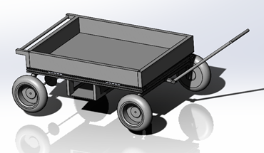
Current CAD Model
Figure 1: Current CAD Model

Slide 6
Design Description
Carriage to Hold Parts
Dovetail Design
Foam-Filled Tires
DC Motor, Lithium Batteries
Hydraulic Jack
Removable Wall, Hinges
Puncture-Resistant Tires

Slide 7

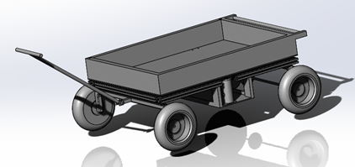
Design Validation
Sturdy Frame
Not Complicated
Easy to Access/Cheap to Replace
Tests and Proof-of-Concept
Figure 2: 80/20 Profile
Figure 3: CAD Design

Slide 8
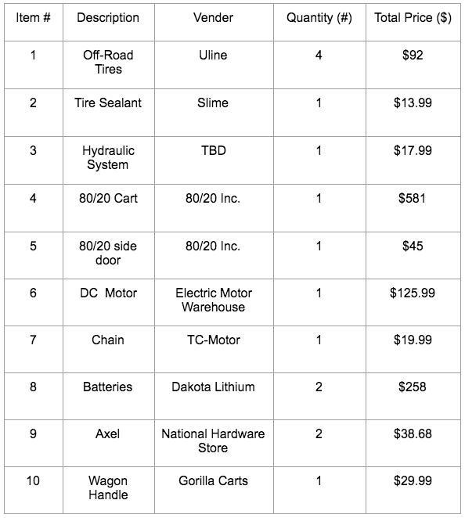

Project Plan- Bill of Materials
Full Sized Model Estimated Total Cost: $1222.63 (no tax)
Figure 2: Bill of Materials

Slide 9
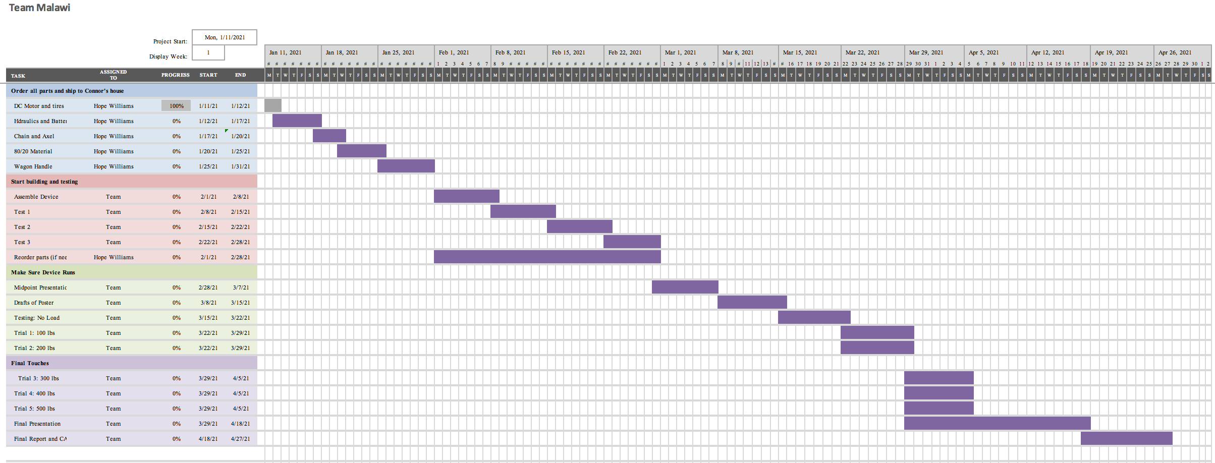
Spring 2021 Project Plan - Gantt Chart
Figure 3: Gantt Chart

Slide 10
Testing Procedures
Tests you will do to prove that:
The engineering requirements are met?
The system works as a whole?
Each subsystem will work?
To ensure the engineering requirements are met, we will
Capacity/Weight Testing
Power Testing

Slide 11
Testing Procedures Continued
To ensure the system works as a whole, we will
Conducting Real-world Tests
To ensure each subsystem will work, we will
Motor and tires: Power Testing
Dumping Mechanism: Weight Testing

Slide 12
Questions?
Team Malawi

